Slide 1
Move
Social Educational Platform based on Virtual Reality

Slide 2
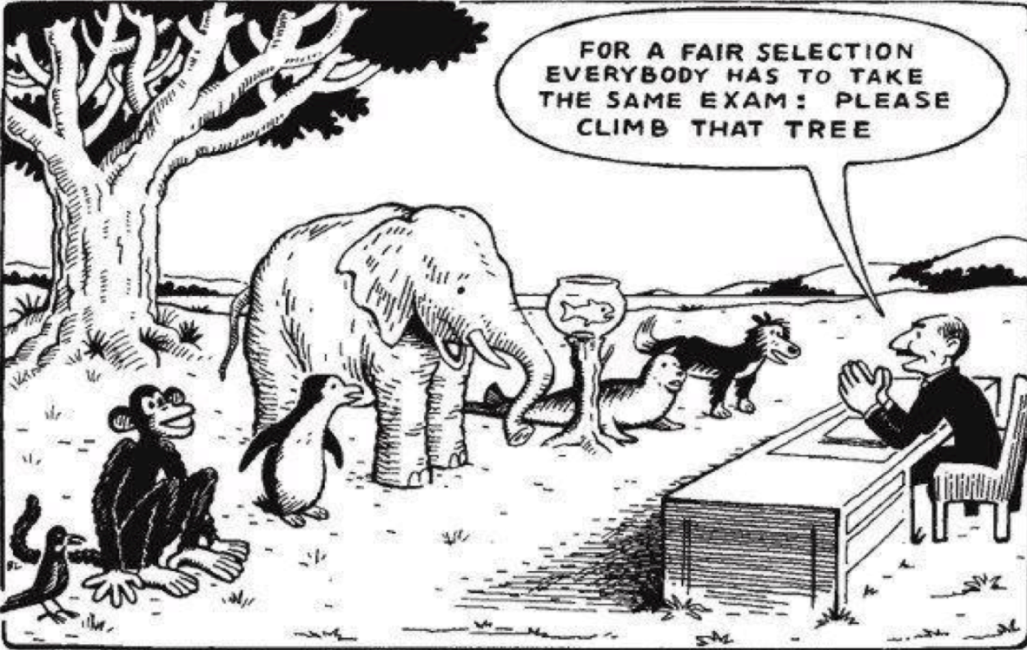
Introduction
Traditional Educational System Problems.
Poor Educational Material leads to poor educational experience.
It’s a communication problem too.
The world is using cool new technologies in education.

Slide 3
Problem Statement
Communications problem reduce the impact of educator’s effort.
All the ways to share materials are expensive or free but distractive.
Ability of remote auditing is a mandatory nowadays.
Visual content is important to make educational experience more powerful.
One of those technologies is Virtual Reality.
VR Experience is rich and interactive but development process is hard and expensive.

Slide 4
The Solution
A social interactive channel is the best solution.
Strong bonds between educators and students.
A free solution we all can share.
For visualization there’s a tool to reduce time, effort and cost of getting a VR educational experience.
Live sessions to serve large sector of students.

Slide 5
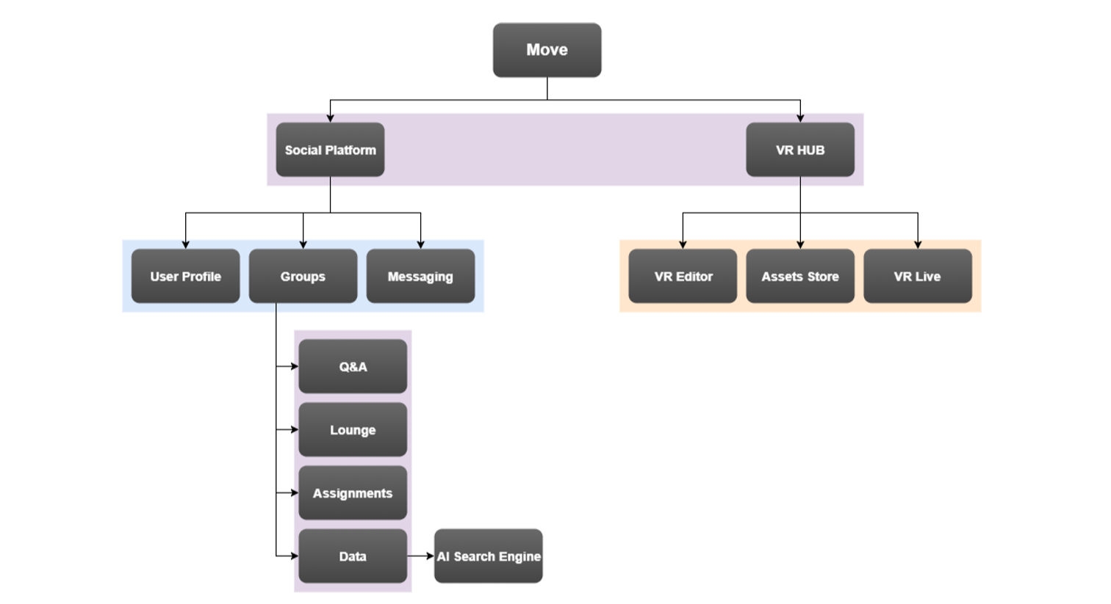
Our System

Slide 6
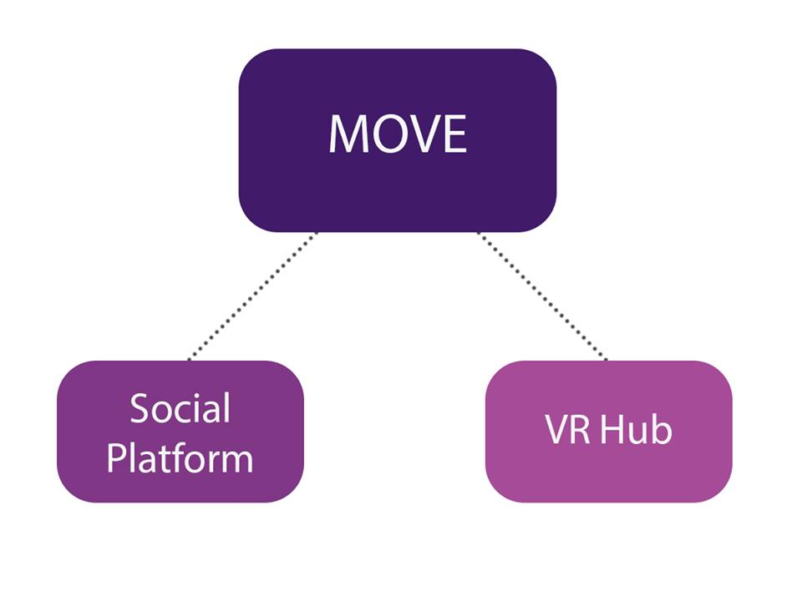
- Social Platform: the modules that handles the interaction between users, study groups, user profiles, news feed, messaging system, etc.
- VR Hub: the module that handles all the VR functionalities like VR Editor, VR Live, VR Asset Store.

Slide 7
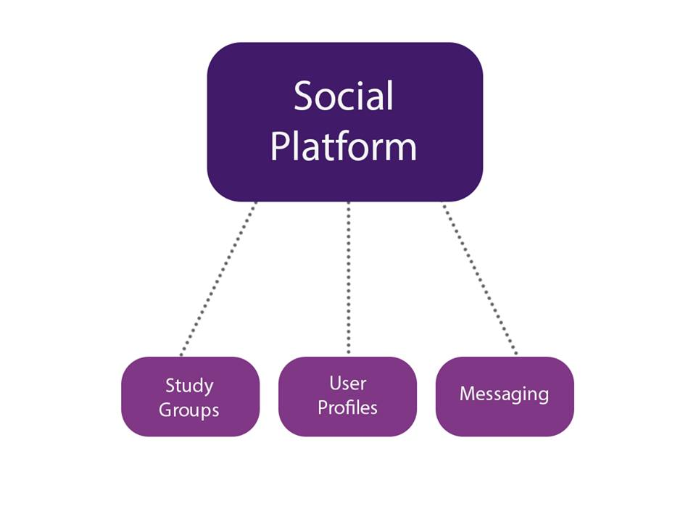
- Study Groups: a place where students, Professors, TAs and school teachers can communicate to have an efficient educational experience.
- User Profiles: each user has his own profile, he/she can post, share stuff also there is the news feed that grabs all feed from different groups.
- Messaging: Absolutely a chat system is mandatory in any social system.

Slide 8
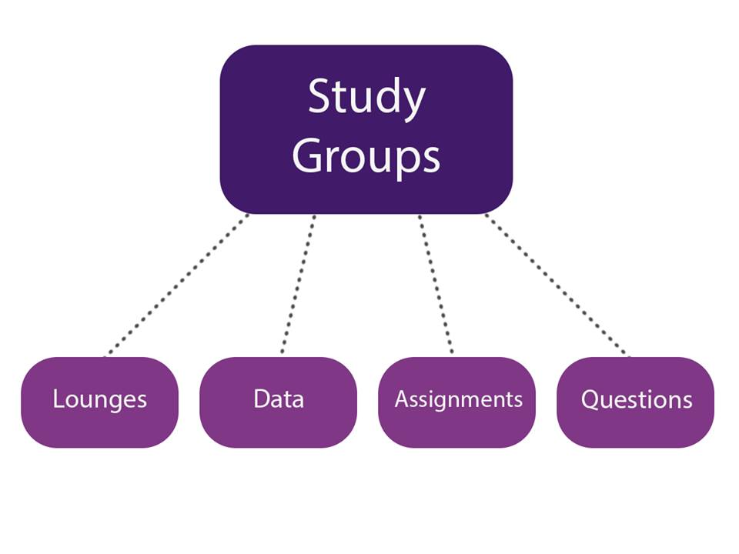
Questions:
- This section is a -Stackoverflow- style.
- Questions and answers can include attachments like images and links.
- Accepted answers, Professors, Teachers and TAs are in control.
- Up and down votes.

Slide 9
Data:
- All data come together in an organized manners.
- Upload, download and view almost every popular format like pdf, links, zip files,
Images, audio and video.
- Mark as favorite for later easy access.
AI Search Engine Included:
1- Speech Recognition Search:

Slide 10
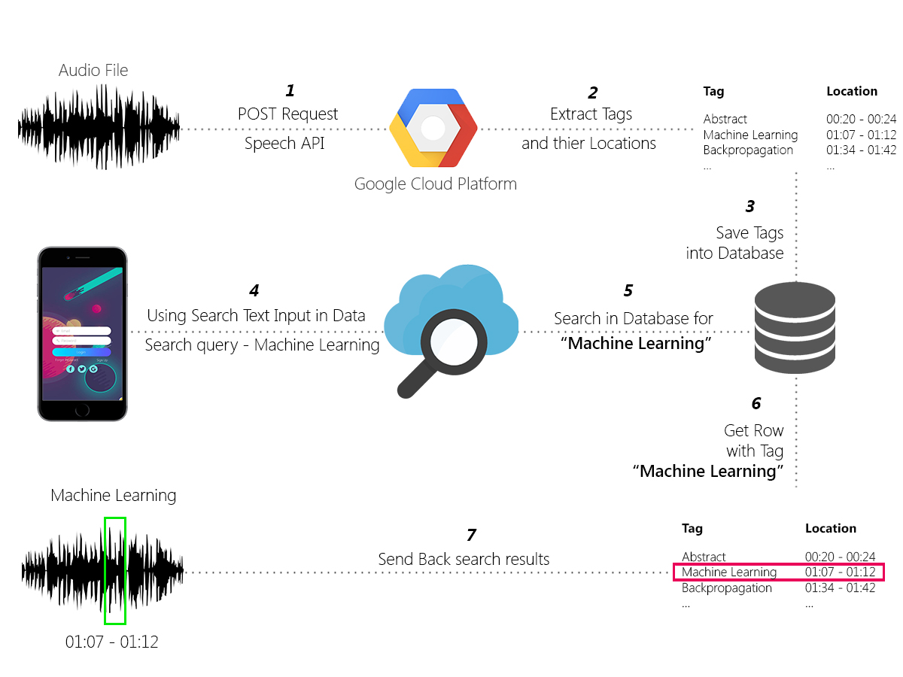

Slide 11
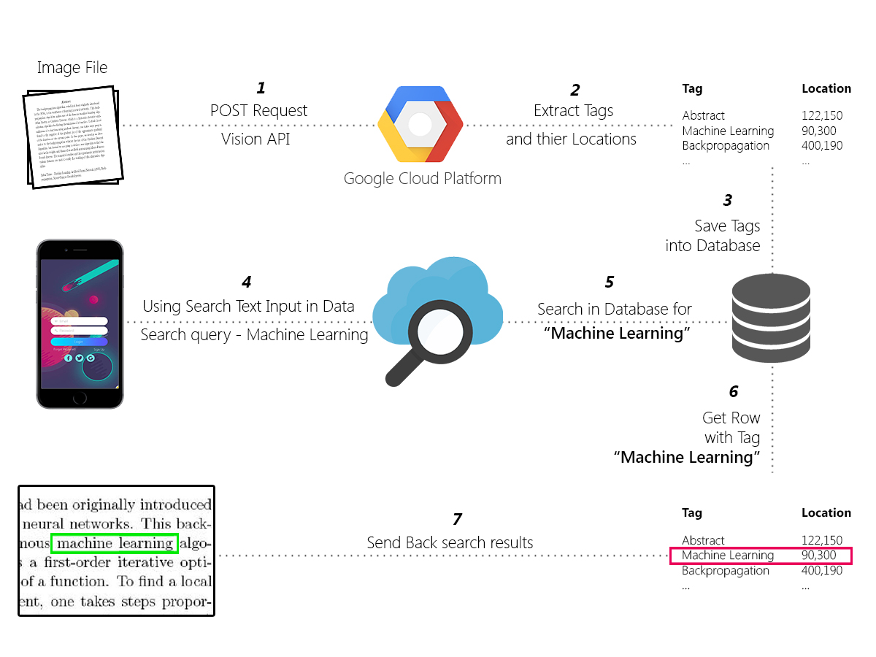
2- Text Recognition Search

Slide 12
Assignments:
- Assignment overview: description, deadline, whether it has been submitted or not yet.
- Live and history sections.
- Online submission.
- Avoid the hassle that we used to have with old traditional ways.
Lounge:
- This is the “Others” or “General” part of every group.
- General posts, announcements, polls, etc.
- Keep in touch with messaging system and following posts for real time notification.

Slide 13
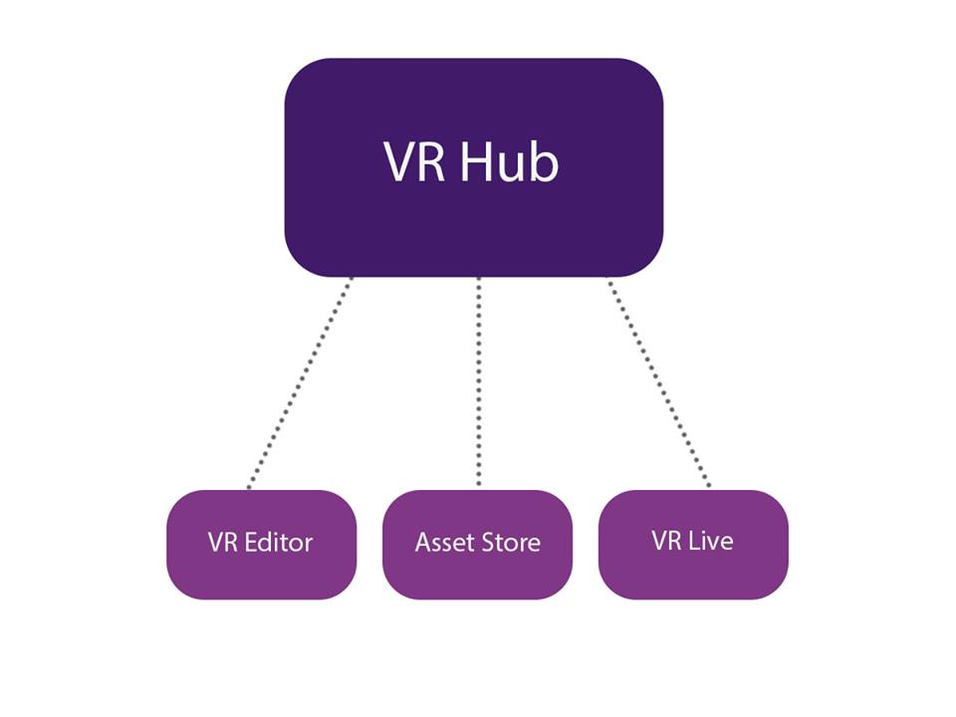
- VR Editor: user can make VR experience with no prior knowledge of coding or graphics using Drag-Drop-Modify processes.
- Asset Store: store is the place where user can use a pre designed asset and import it inside his/her underdevelopment VR experience or upload assets and it will also be a great opportunity for 3d Designers, Animators, Game Artists, SFX Designers to upload their work and get paid.

Slide 14
- VR Live: after the user creates a VR experience he/she will be able to publish it using VR Live feature,
so other users can try it, the VR Live session will also have a live stream for the instructor voice, some helpers tools like the white board, etc..

Slide 15
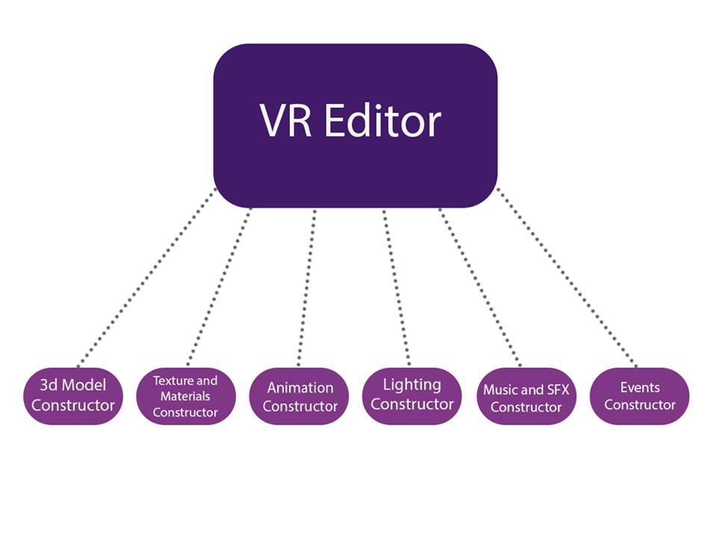
- 3D Model Constructor: enables user to import 3D Models from the asset store or uploaded manually by user.
- Textures & Materials Constructor: enables user to make or use textures & materials for the 3D models in the scene.
- Animation Constructor: enables user to make or user pre designed animations for the 3d models inside the scene.

Slide 16
- Lighting Constructor: enables user to construct and edit Lighting & Shadows inside the scene.
- Music & SFX Constructor: enables user to use Music and sound effects inside the scene.
- Events Constructor: enables user to make interactions between game objects using VR controllers with zero coding just use blocks (something like scratch programming).

Slide 17
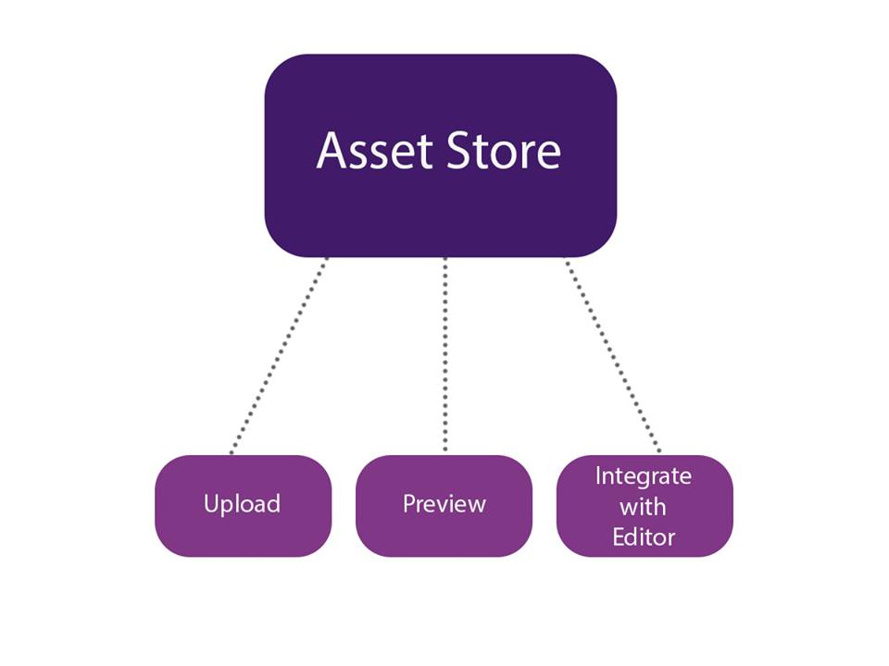
- Upload asset: user can upload his/her own custom assets and make it free or paid.
- preview asset: user can preview 3d assets and materials so he/she can use it in the VR Editor.
- Integrate with VR Editor: an integration with the VR Editor to enable users to use any assets to make their experience.

Slide 18
- VR Experience Arena: the place where you choose the experience which you want to try.
- In Experience Audio Streaming: Instructor can audio stream his/her voice so students attending the live sessions while trying the experience can hear his voice and follow his instructions.
- In Experience Helpers Tools: Instructor can use some helpers tools within the experience like VR white board, etc..

Slide 19
VR Editor:
Used by the user to build the VR experience.
User doesn't have to have any background in development and 3D design.
User uses basic assets and external assets to build the scene with.
User can modify the properties of the objects he/she created from a GUI controllers.
User can add audio to the experience.

Slide 20
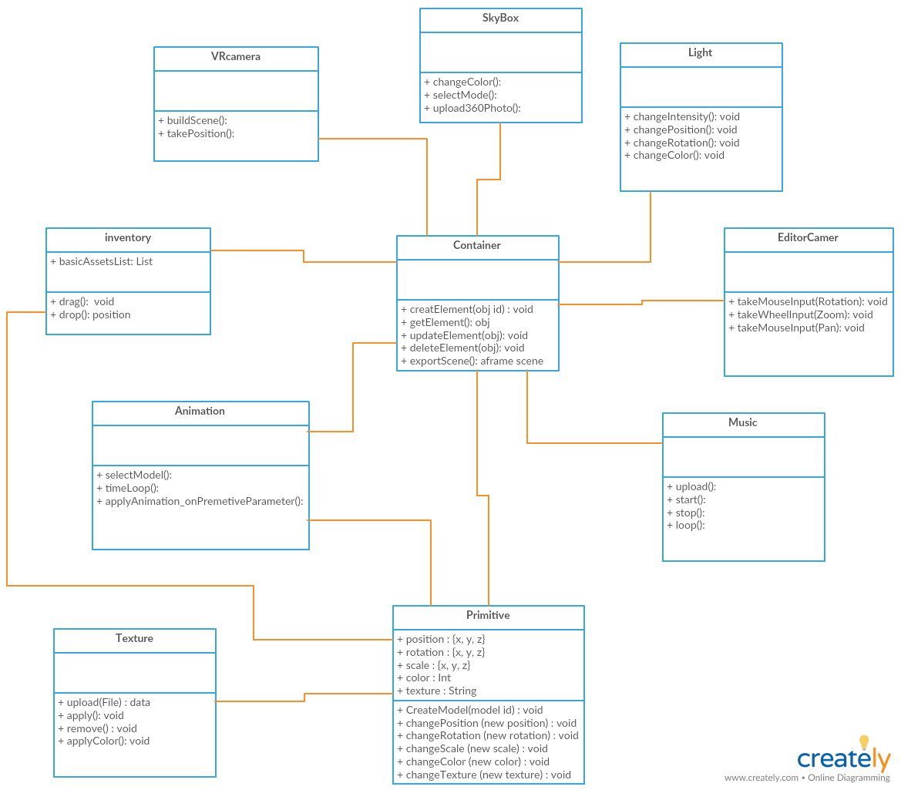

Slide 21
Assets store
A place integrated with VR editor that user can access to import external assets (Models).
Freelancers can push their assets to the assets store.
The assets store contains Models, Audios, UI components, Experiences.

Slide 22
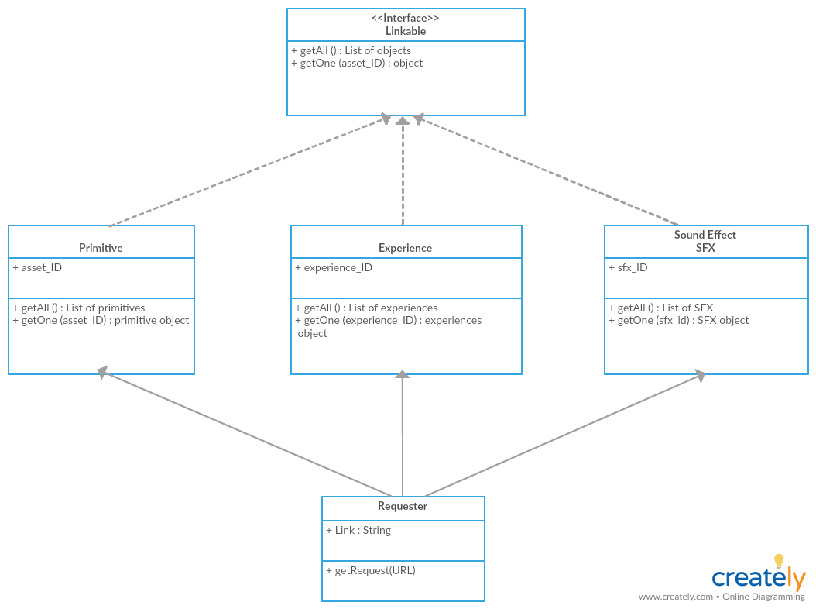

Slide 23
VR Live:
A place that hosts the experiences that users can interact with, and search among various categories.
User use the head mount to enter the experience and try it.

